Slide 1
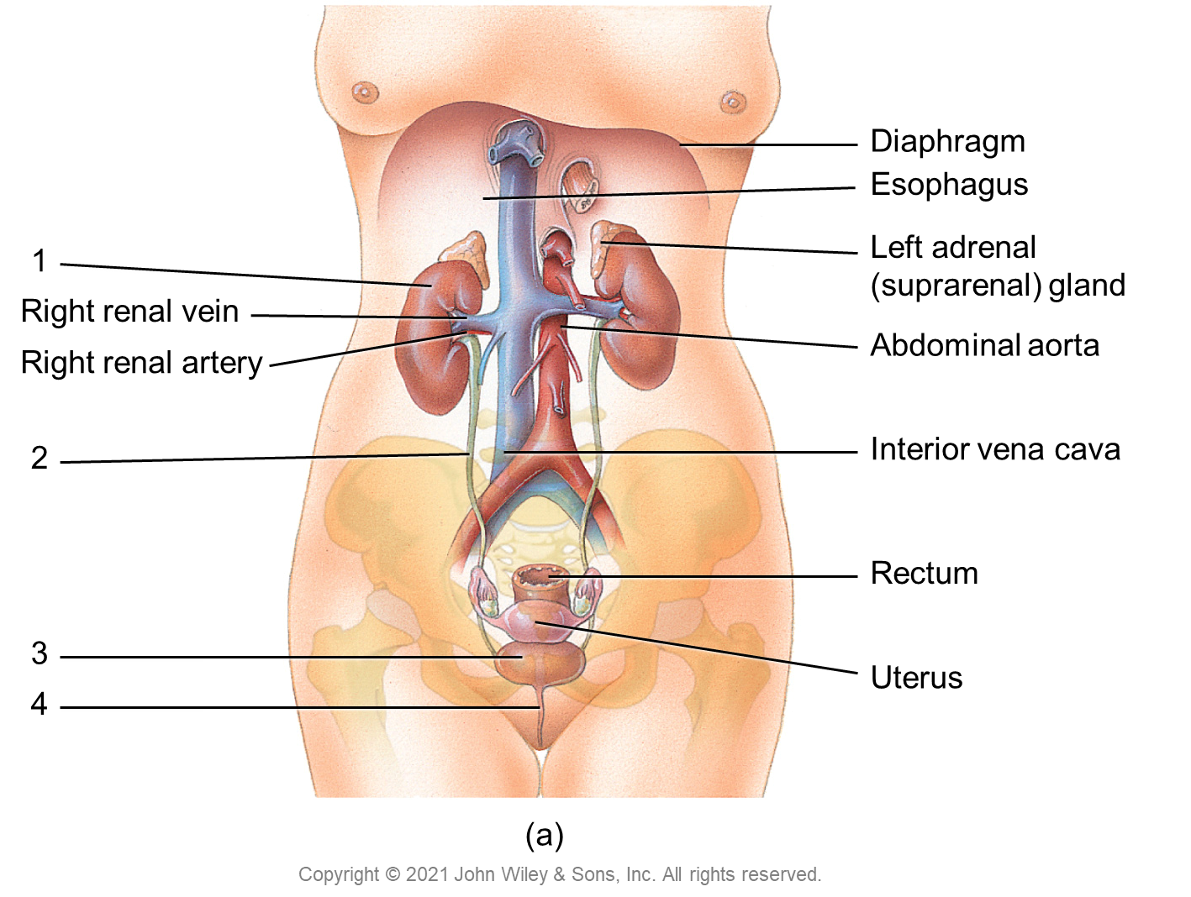
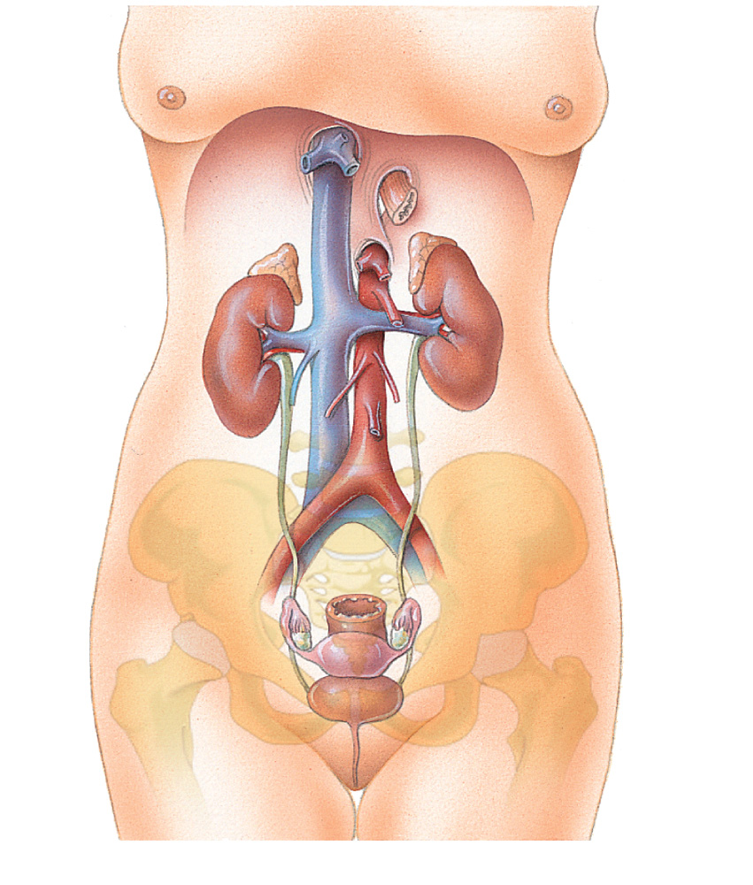
Diaphragm
Esophagus
1
Left adrenal (suprarenal) gland
Right renal vein
Right renal artery
Abdominal aorta
2
Interior vena cava
Rectum
3
Uterus
4
(a)
Copyright © 2021 John Wiley & Sons, Inc. All rights reserved.

Slide 2
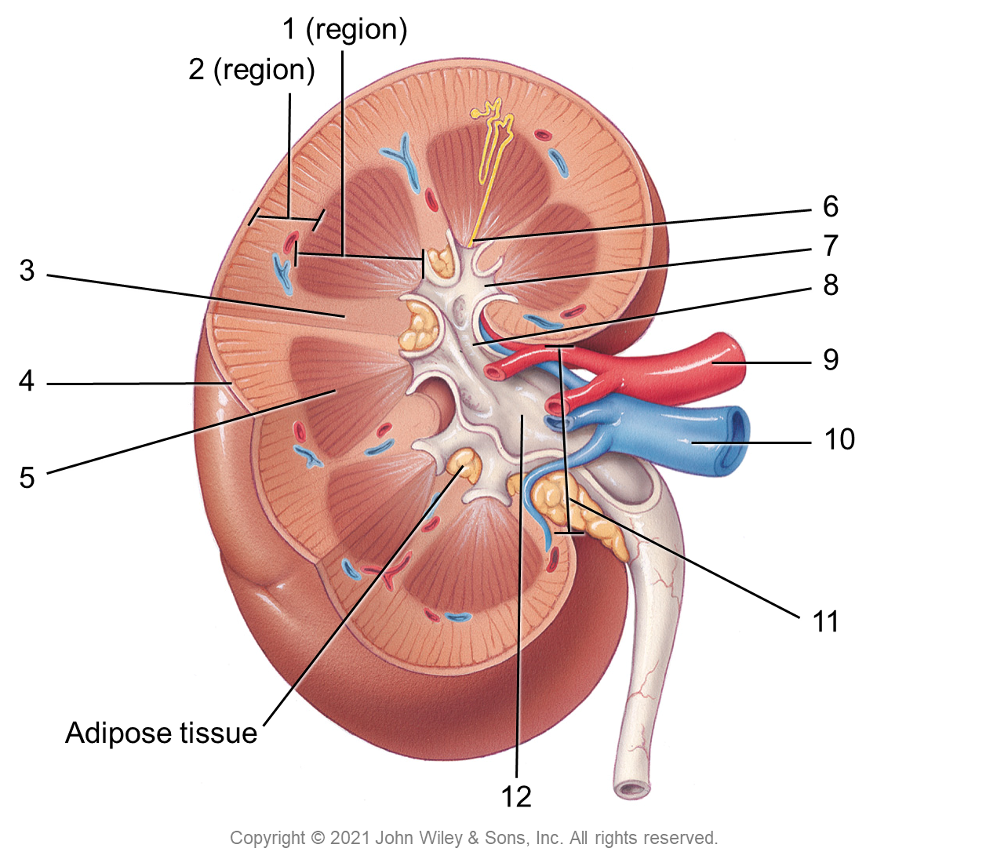
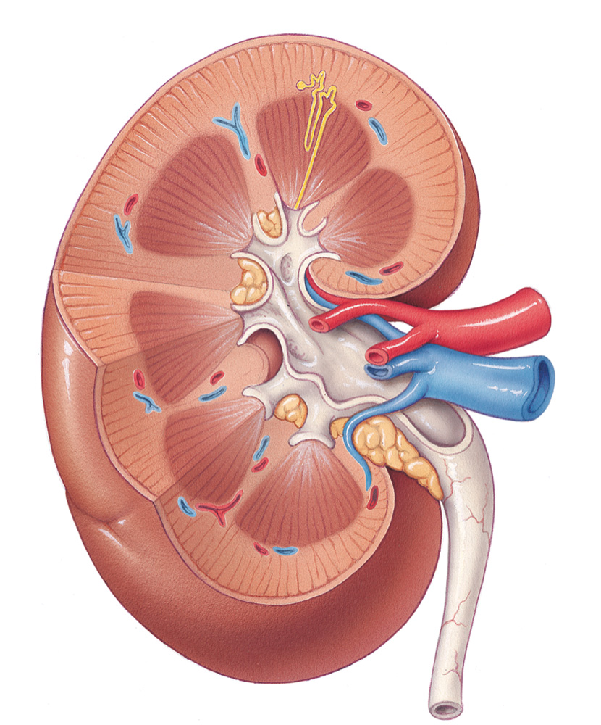
1 (region)
2 (region)
6
7
3
8
9
4
10
5
11
Adipose tissue
12
Copyright © 2021 John Wiley & Sons, Inc. All rights reserved.

Slide 3
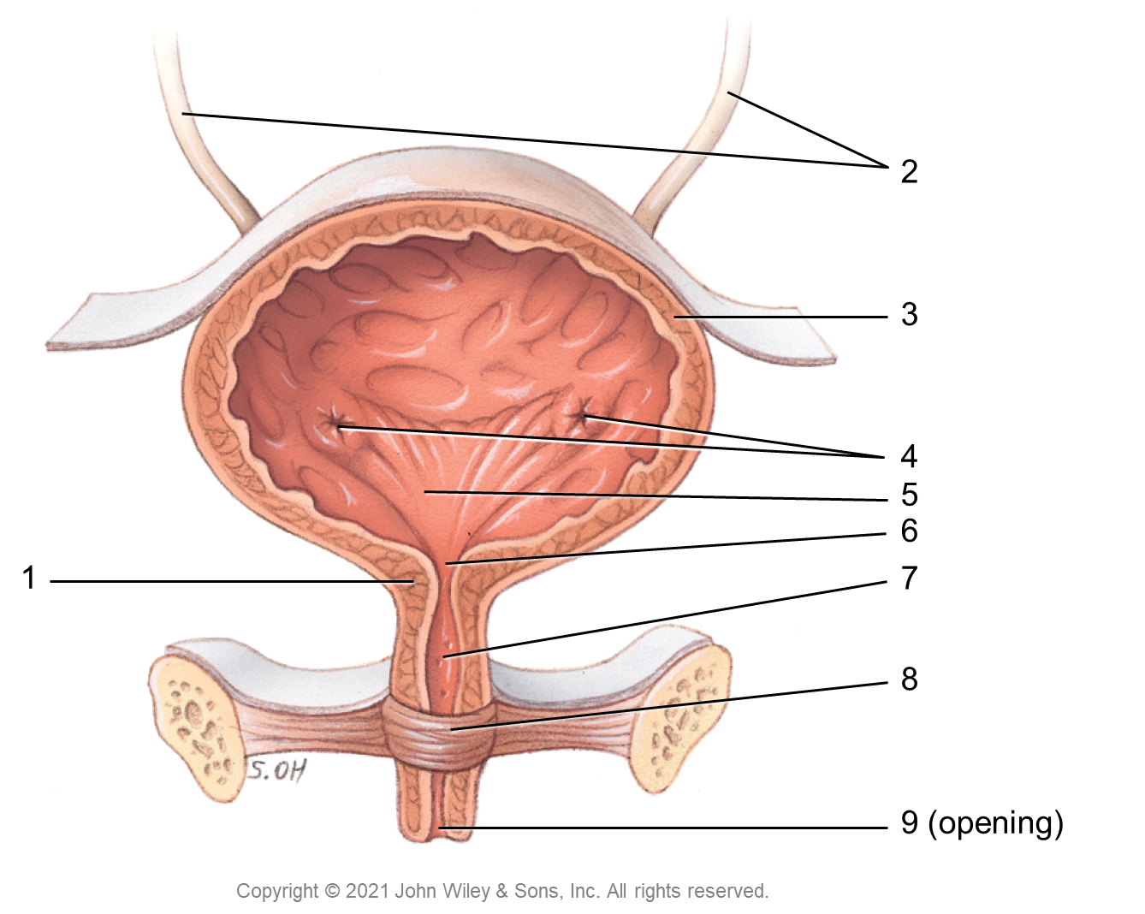
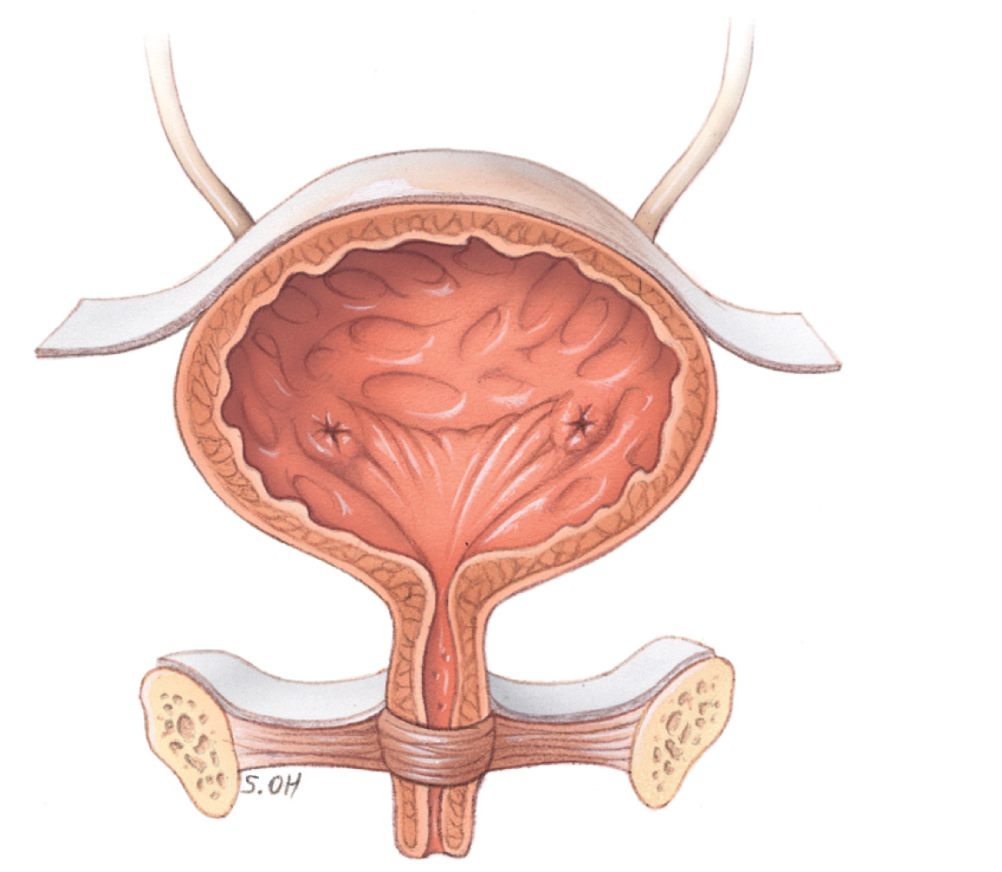
2
3
4
5
6
1
7
8
9 (opening)
Copyright © 2021 John Wiley & Sons, Inc. All rights reserved.

Slide 4
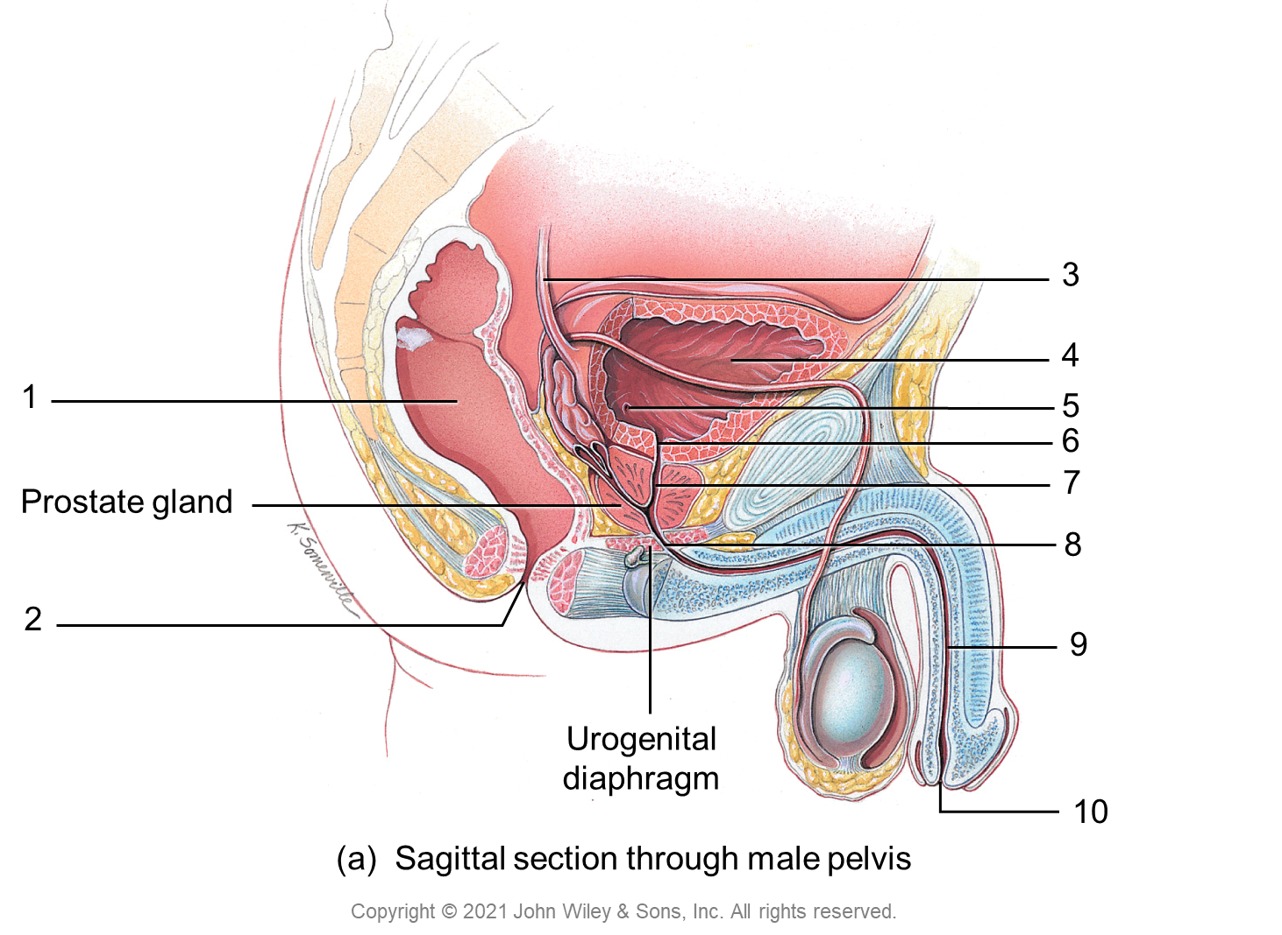
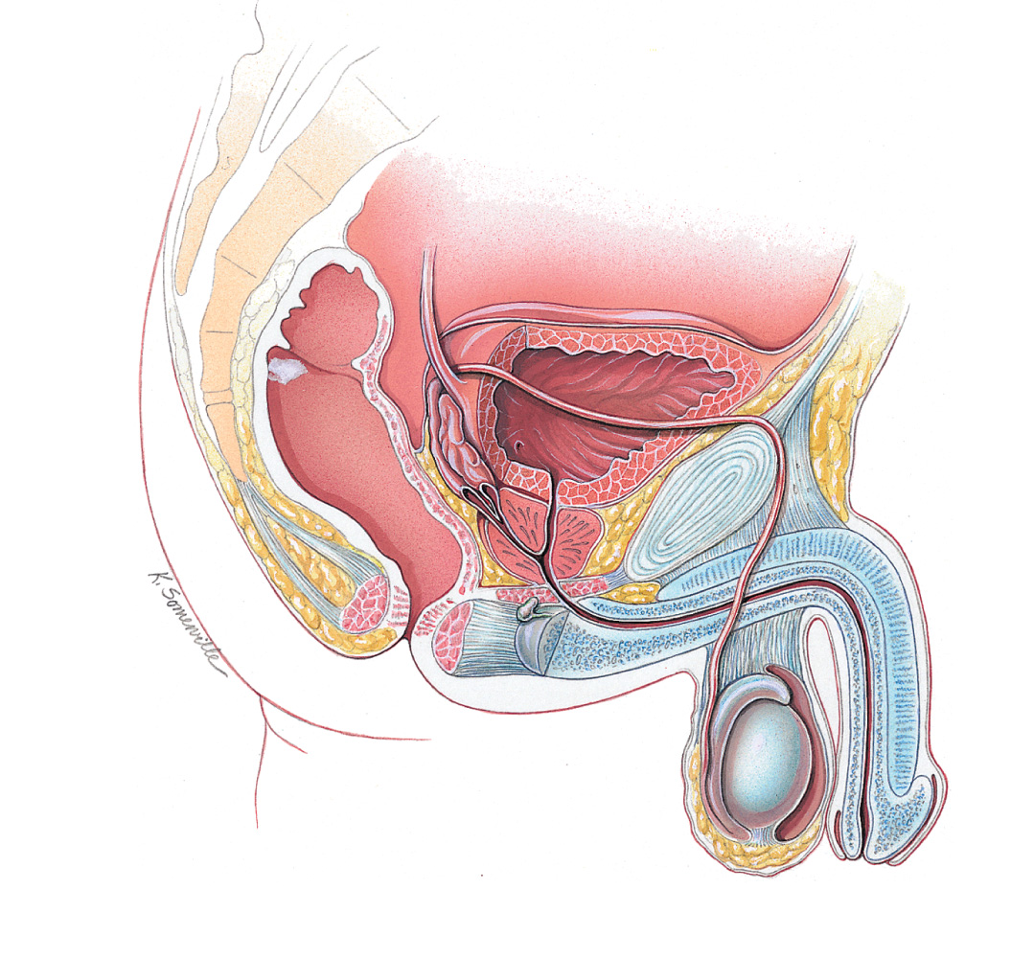
3
4
1
5
6
Prostate gland
7
8
2
9
Urogenital diaphragm
10
(a) Sagittal section through male pelvis
Copyright © 2021 John Wiley & Sons, Inc. All rights reserved.

Slide 5
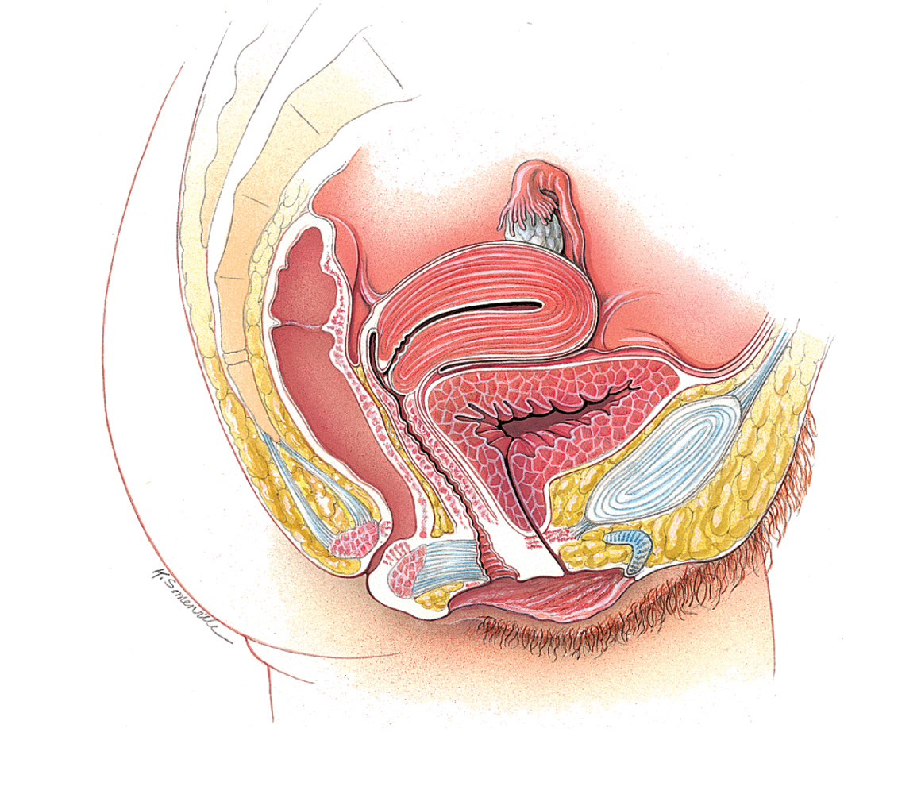
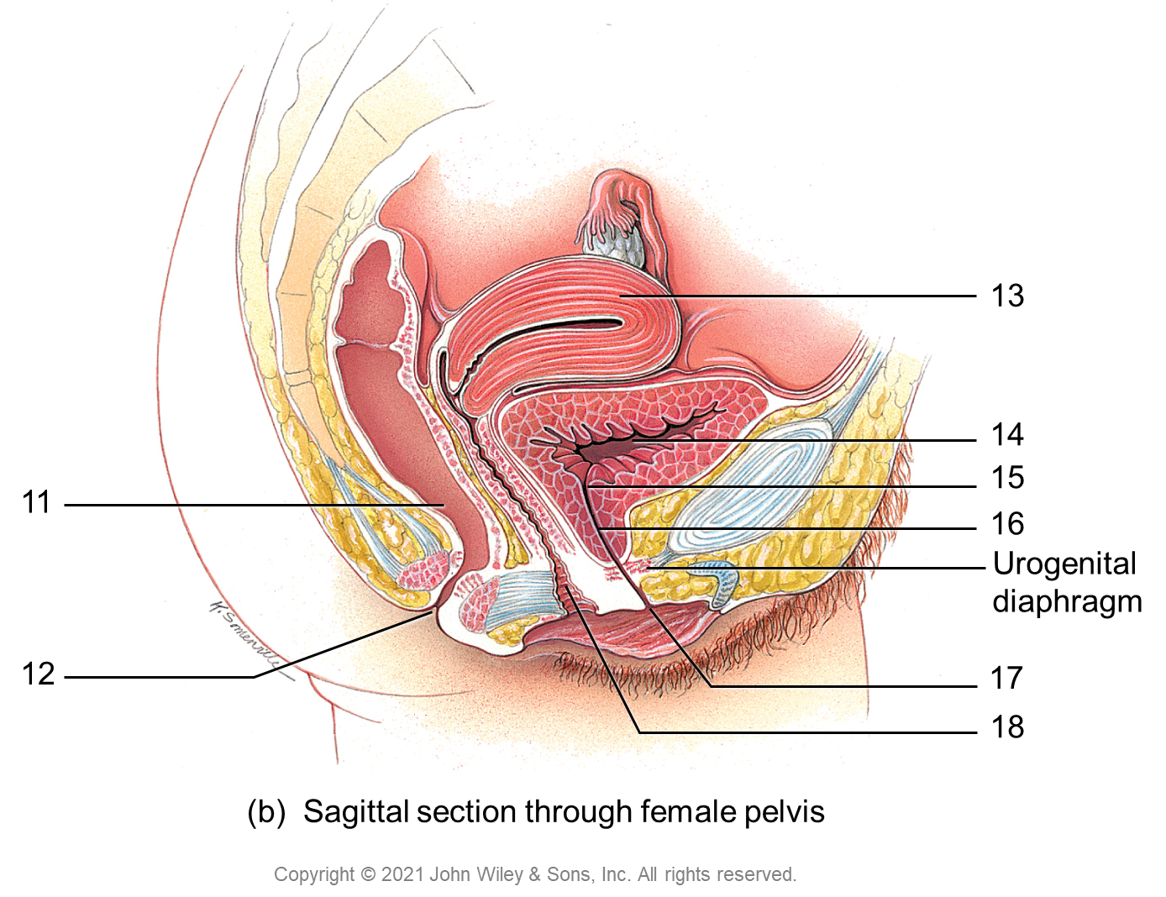
13
14
15
11
16
Urogenital diaphragm
12
17
18
(b) Sagittal section through female pelvis
Copyright © 2021 John Wiley & Sons, Inc. All rights reserved.

Slide 6
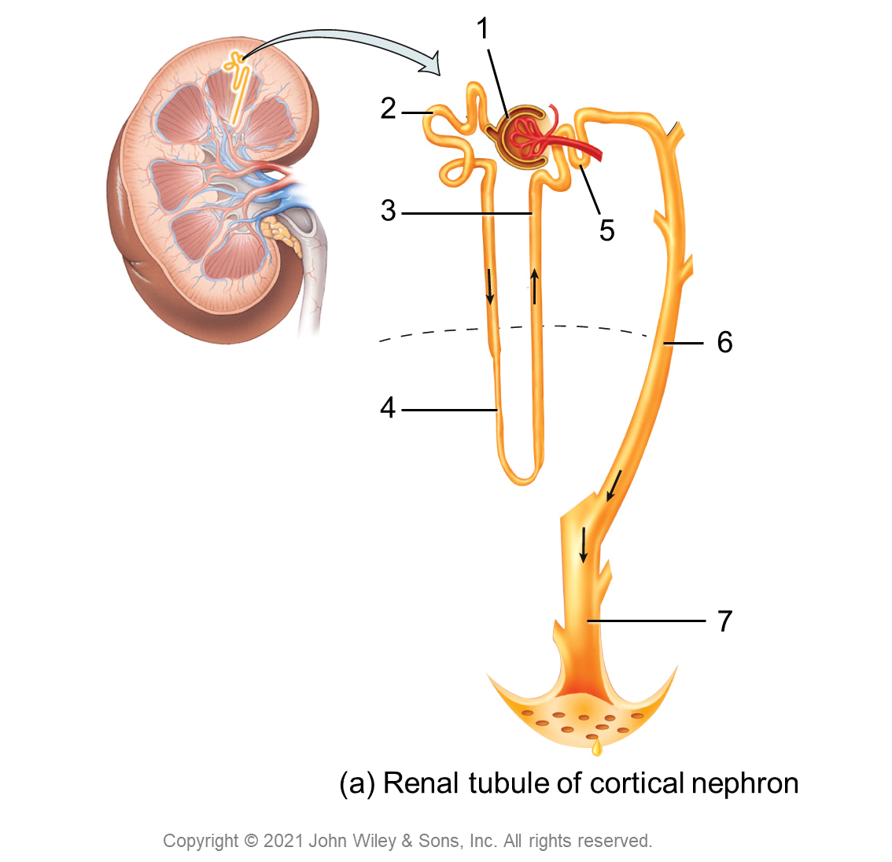
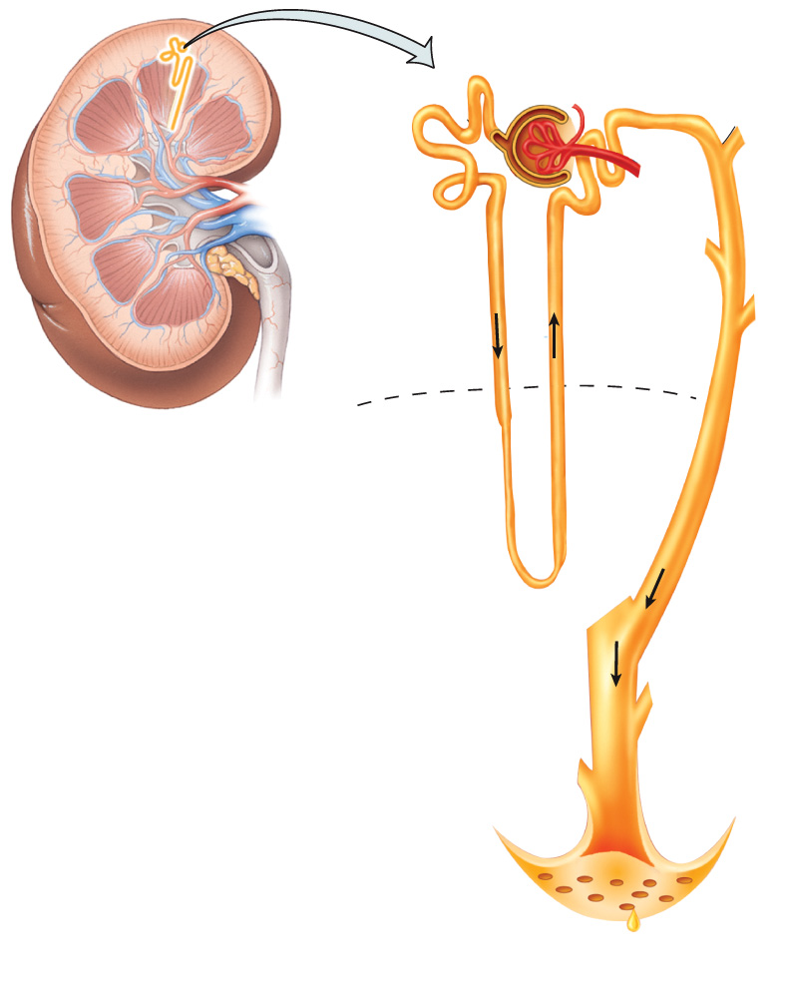
1
2
3
5
6
4
7
(a) Renal tubule of cortical nephron
Copyright © 2021 John Wiley & Sons, Inc. All rights reserved.

Slide 7
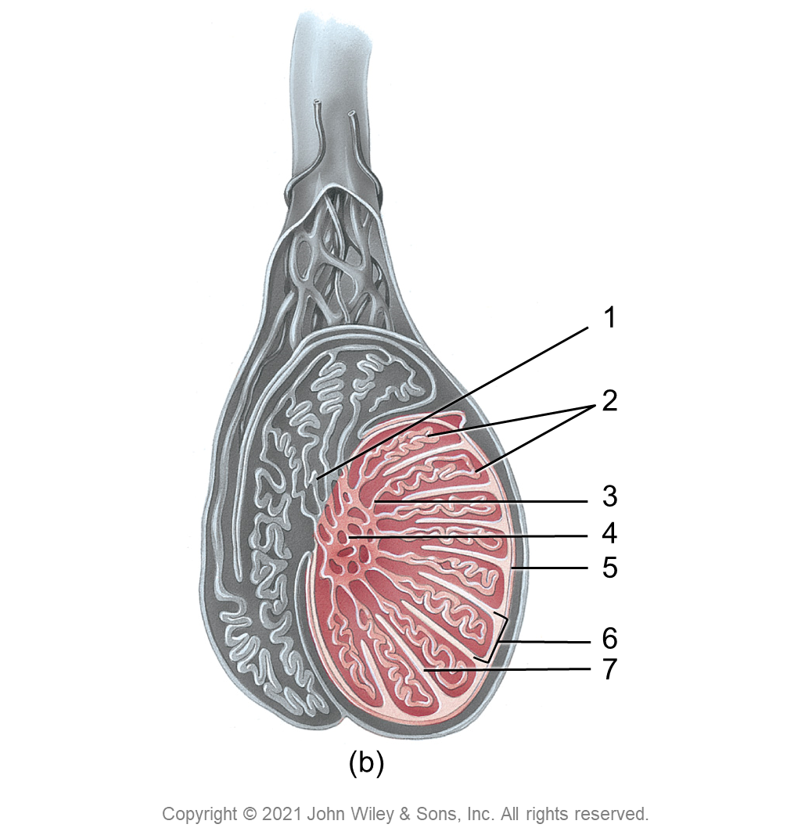
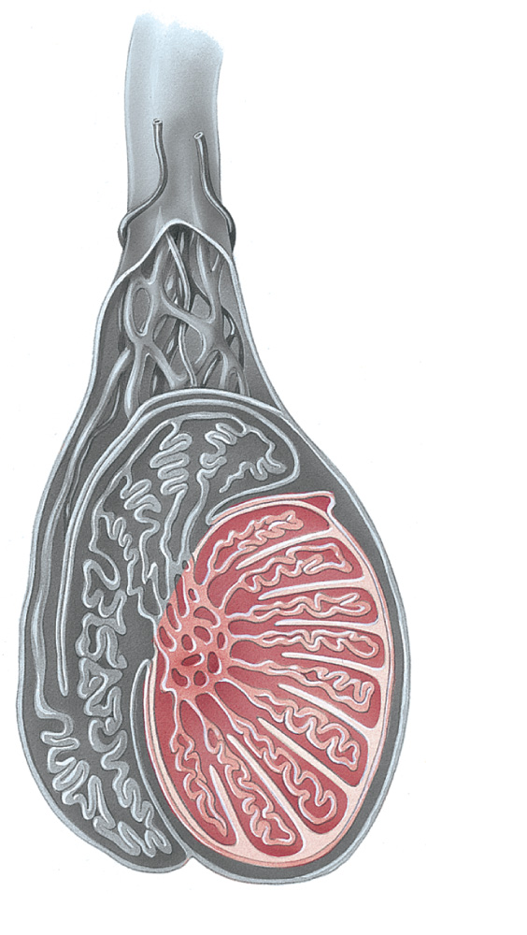
1
2
3
4
5
6
7
(b)
Copyright © 2021 John Wiley & Sons, Inc. All rights reserved.

Slide 8
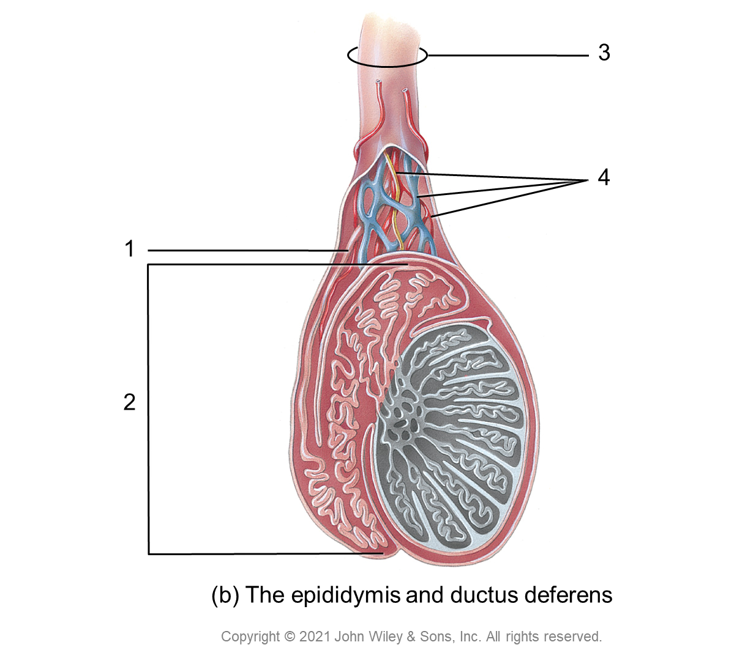
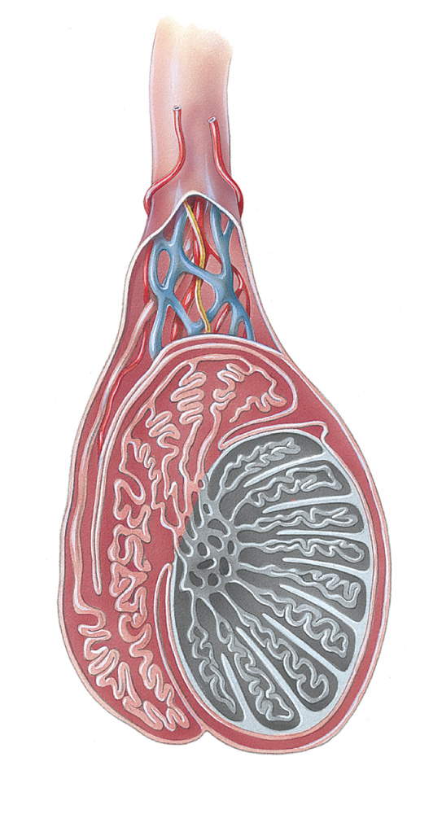
3
4
1
2
(b) The epididymis and ductus deferens
Copyright © 2021 John Wiley & Sons, Inc. All rights reserved.

Slide 9
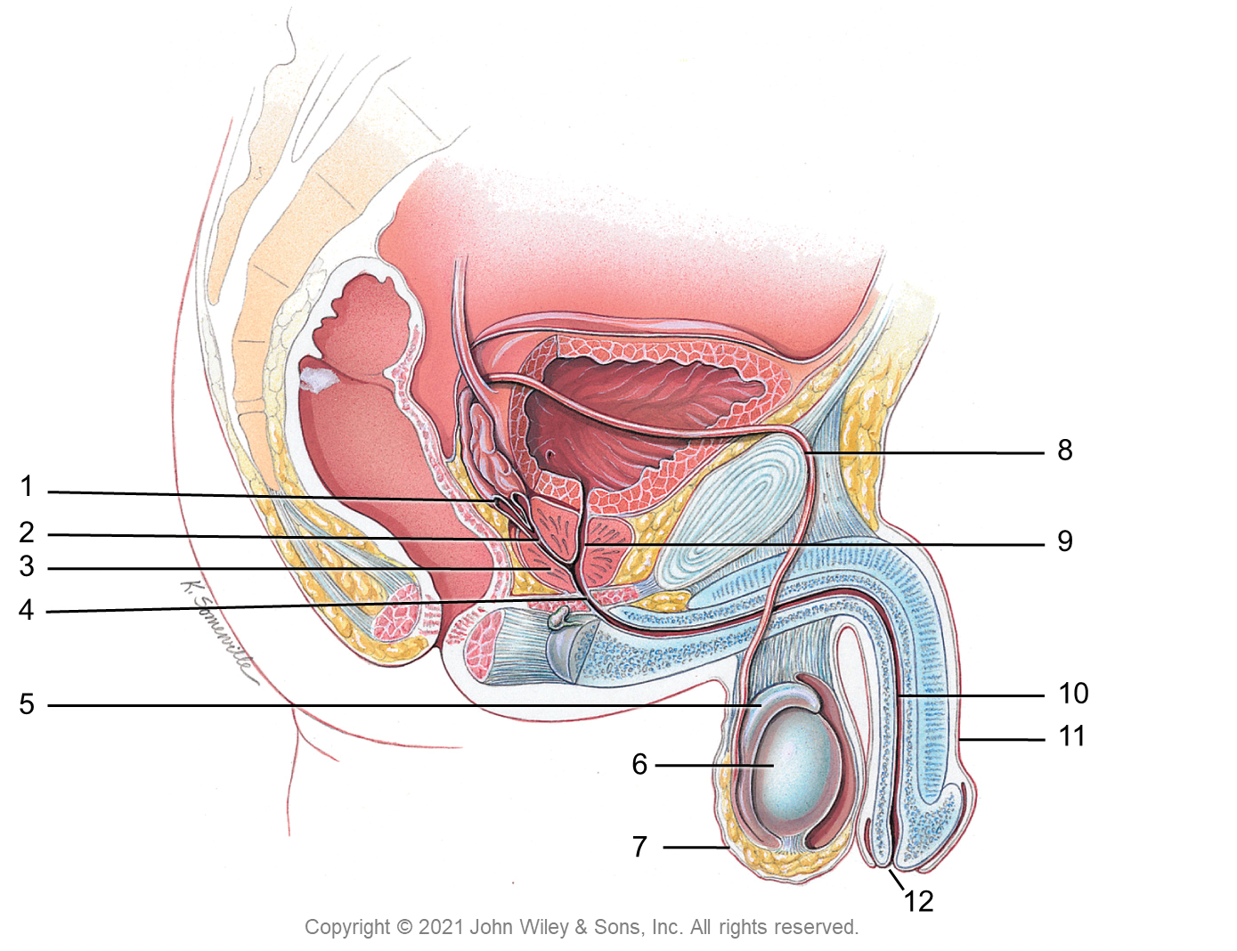
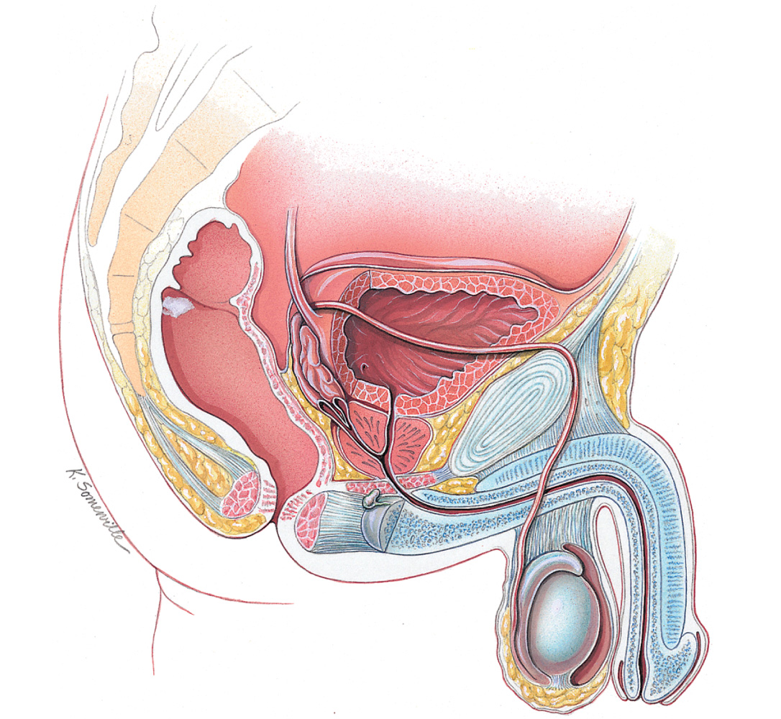
8
1
2
9
3
4
5
10
11
6
7
12
Copyright © 2021 John Wiley & Sons, Inc. All rights reserved.

Slide 10
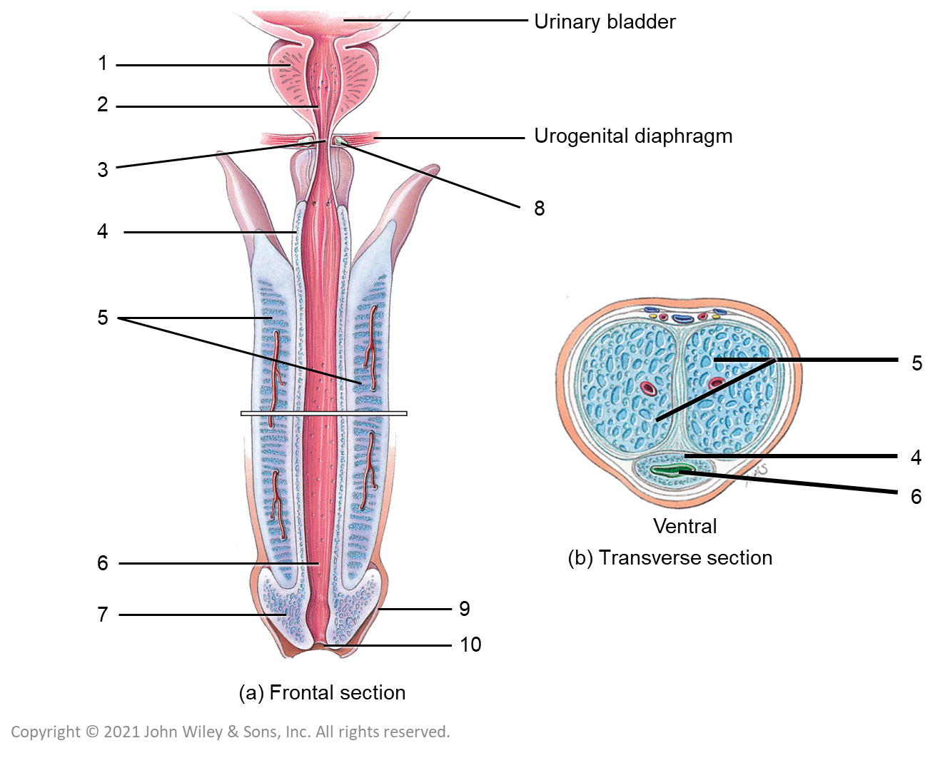
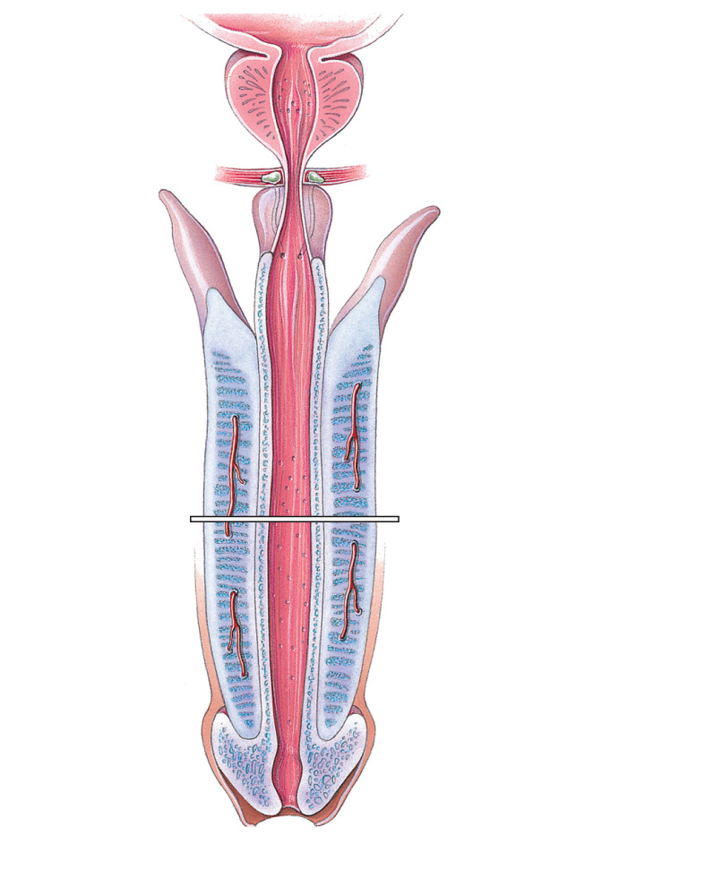
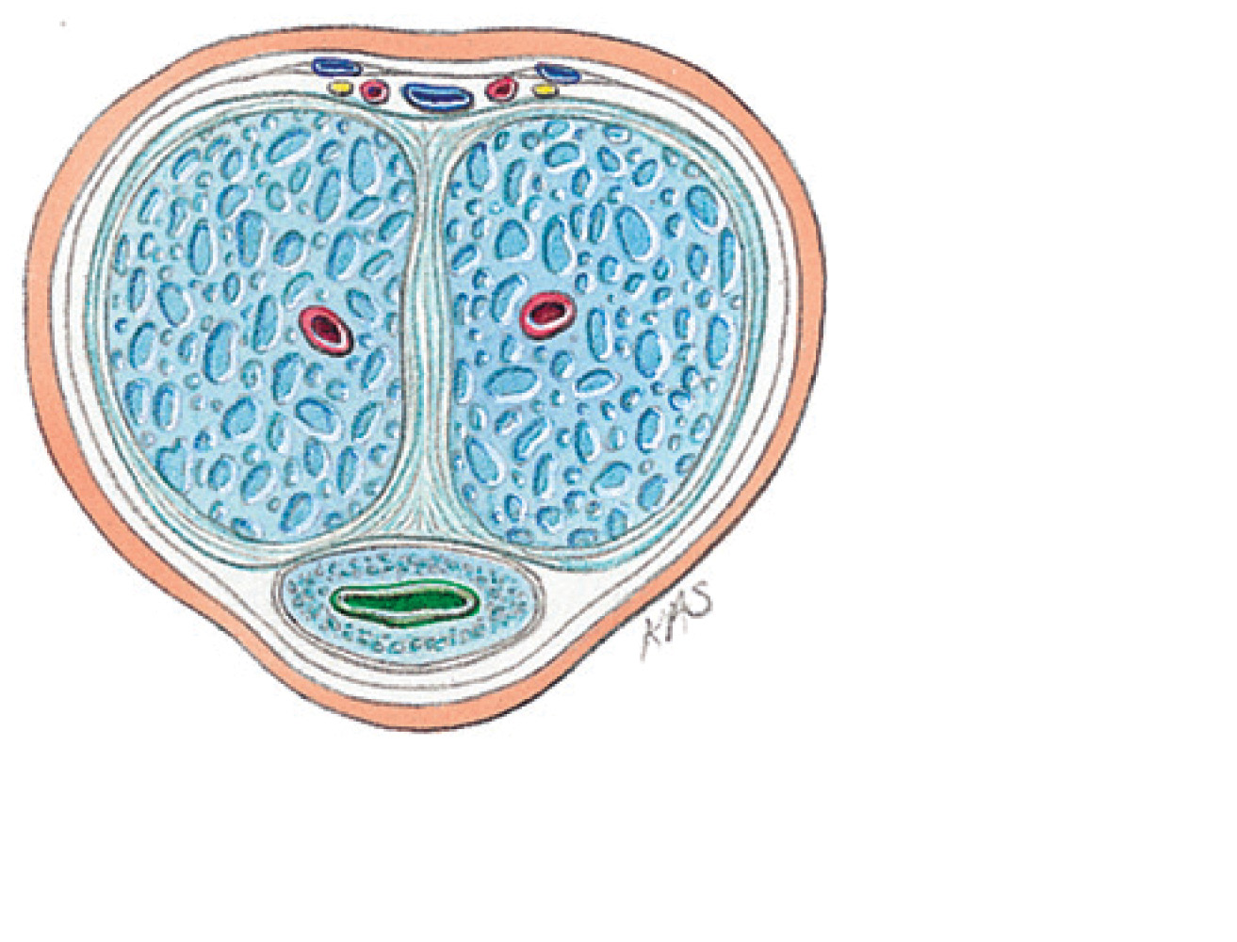
Urinary bladder
1
2
Urogenital diaphragm
3
8
4
5
5
4
6
Ventral
6
(b) Transverse section
7
9
10
(a) Frontal section
Copyright © 2021 John Wiley & Sons, Inc. All rights reserved.

Slide 11
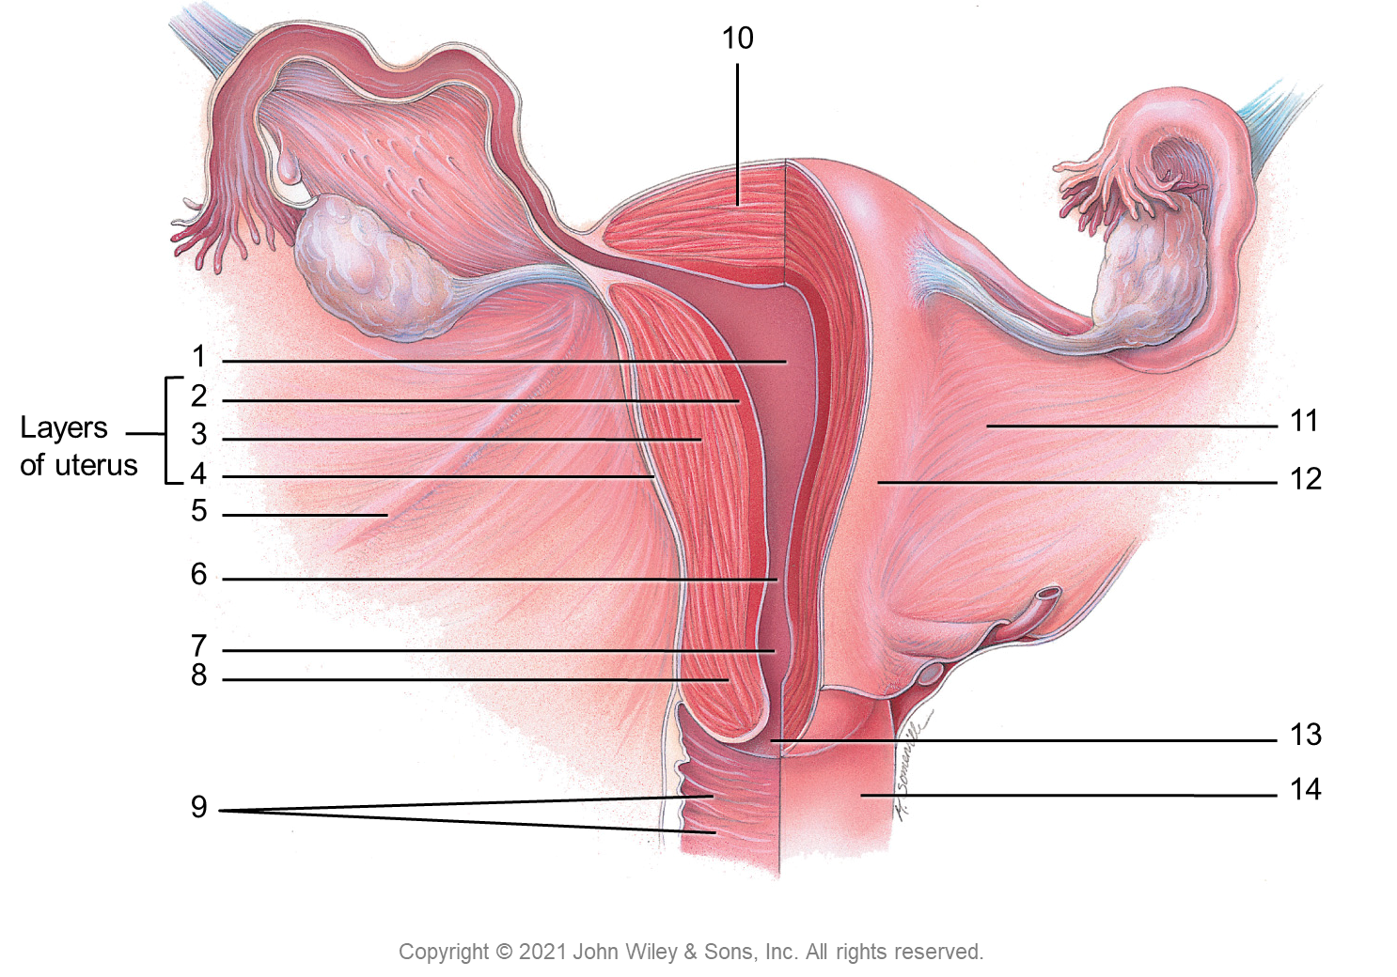
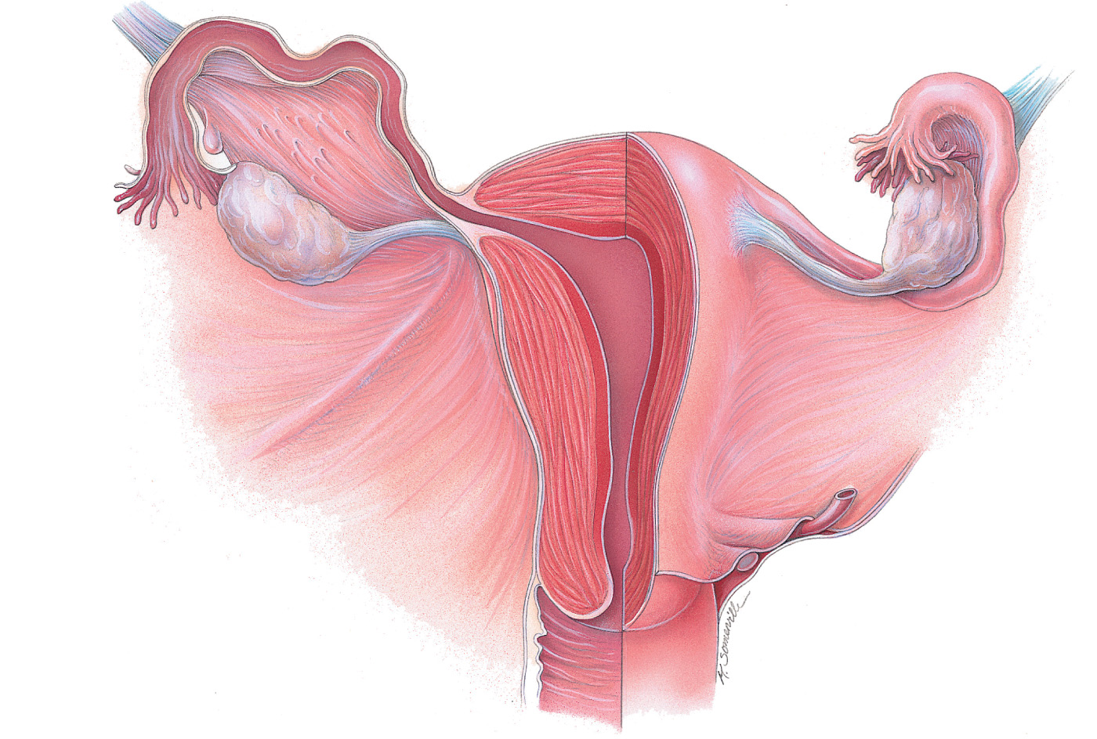
10
1
2
Layers
of uterus
3
11
4
12
5
6
7
8
13
9
14
Copyright © 2021 John Wiley & Sons, Inc. All rights reserved.

Slide 12
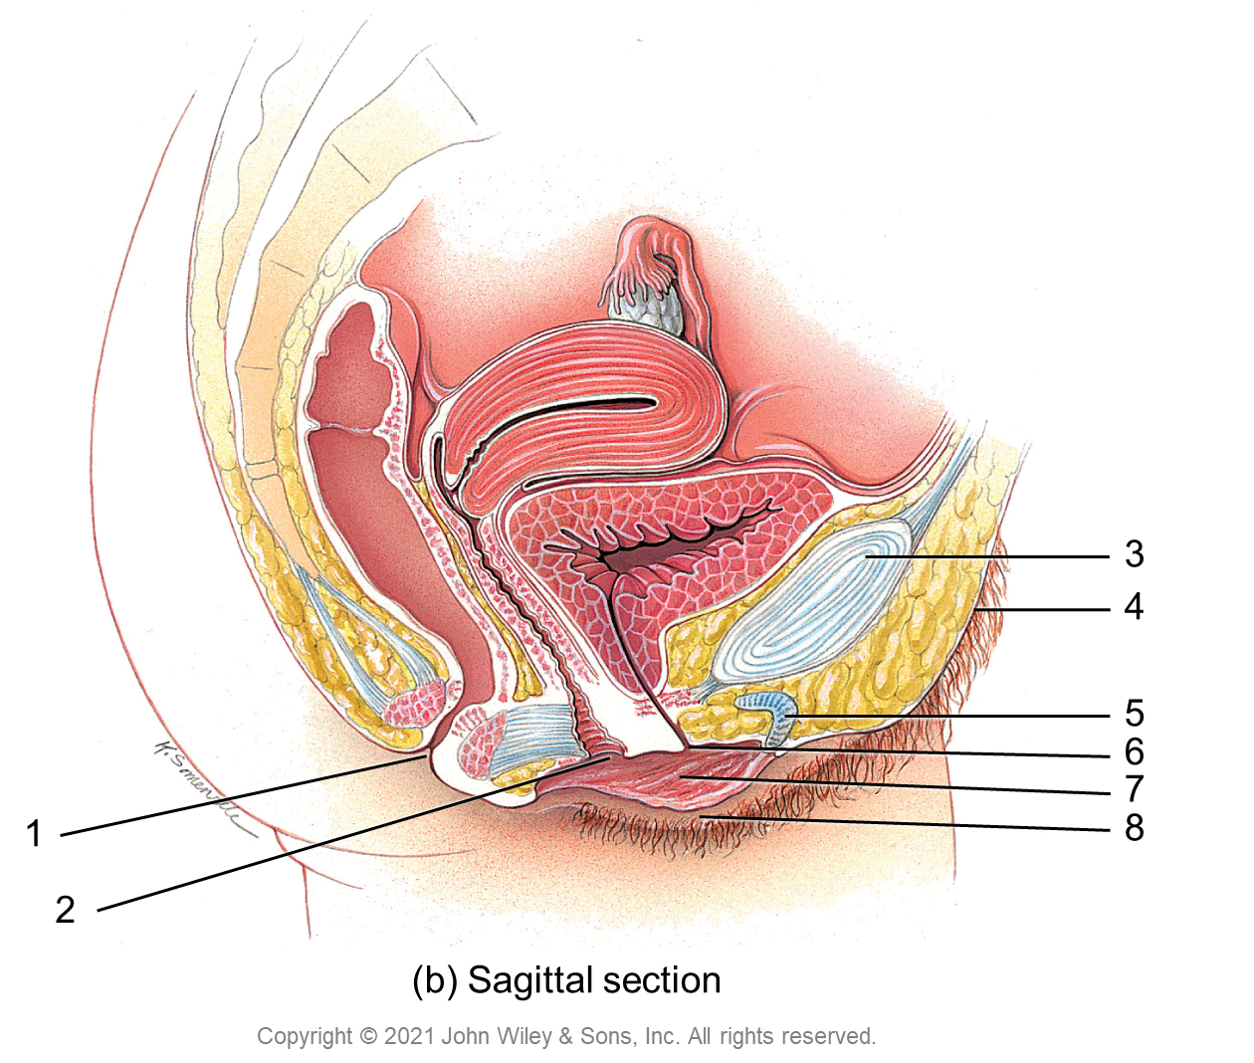
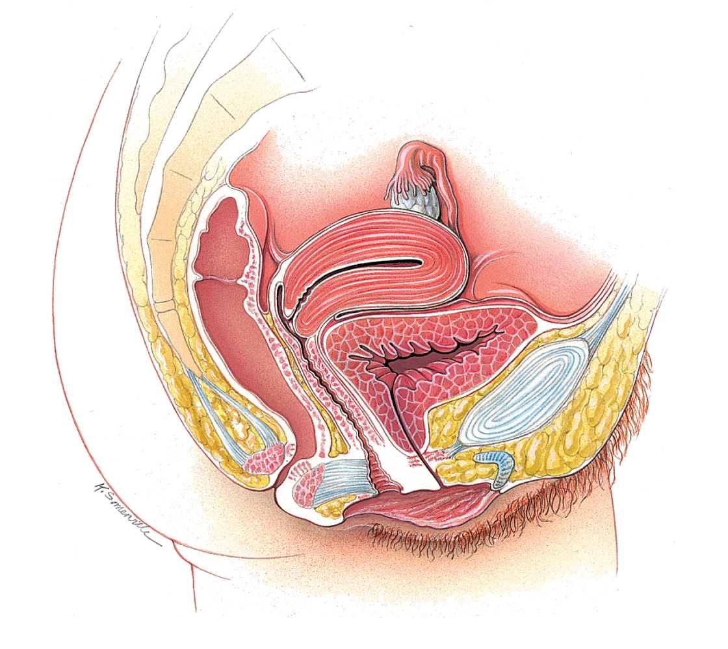
3
4
5
6
7
1
8
2
(b) Sagittal section
Copyright © 2021 John Wiley & Sons, Inc. All rights reserved.

Slide 13
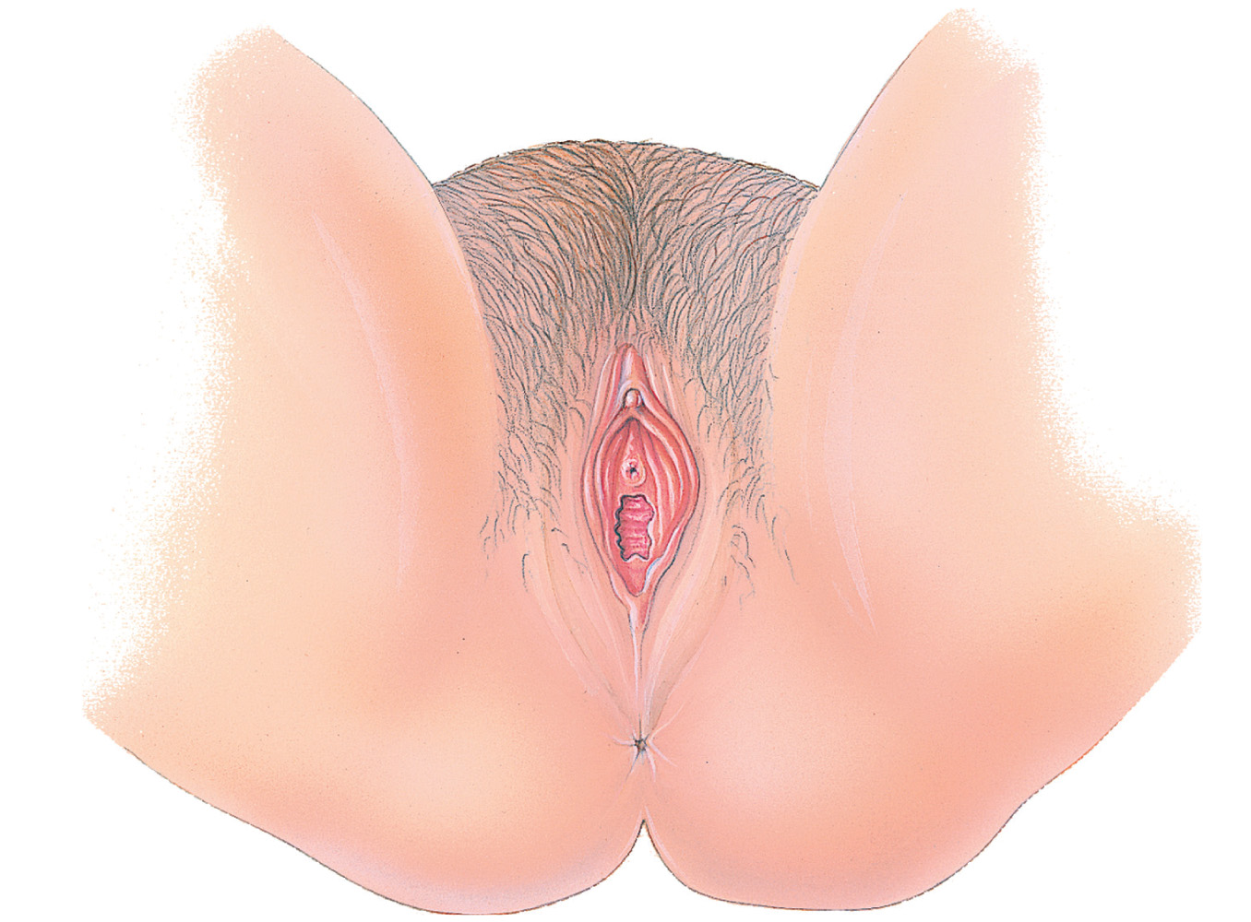
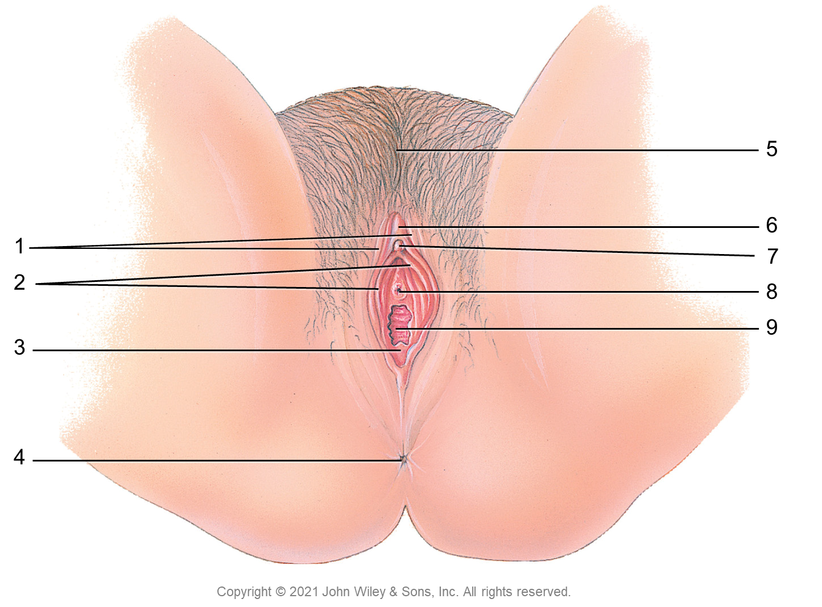
5
6
1
7
2
8
9
3
4
Copyright © 2021 John Wiley & Sons, Inc. All rights reserved.

Slide 14
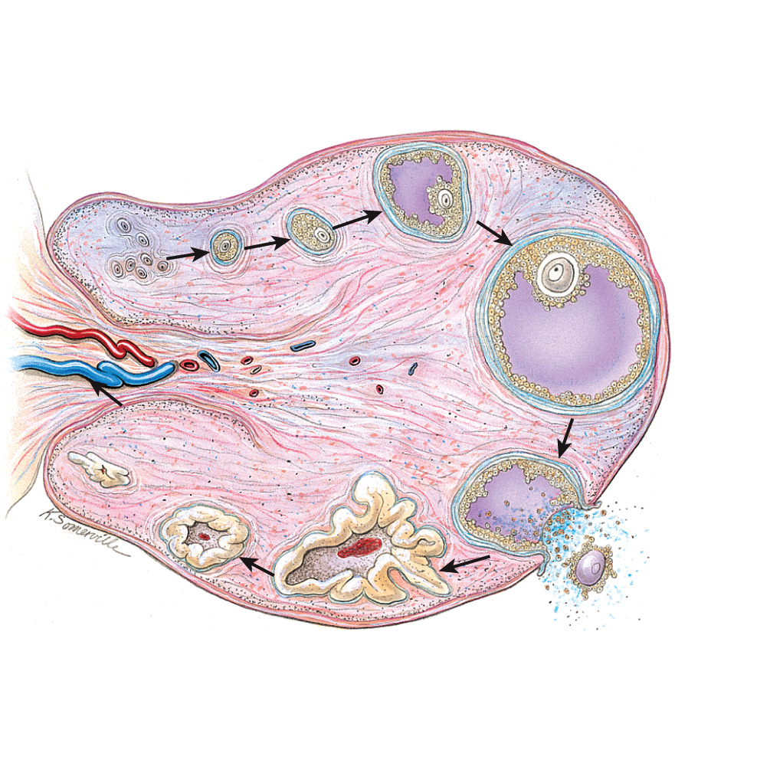
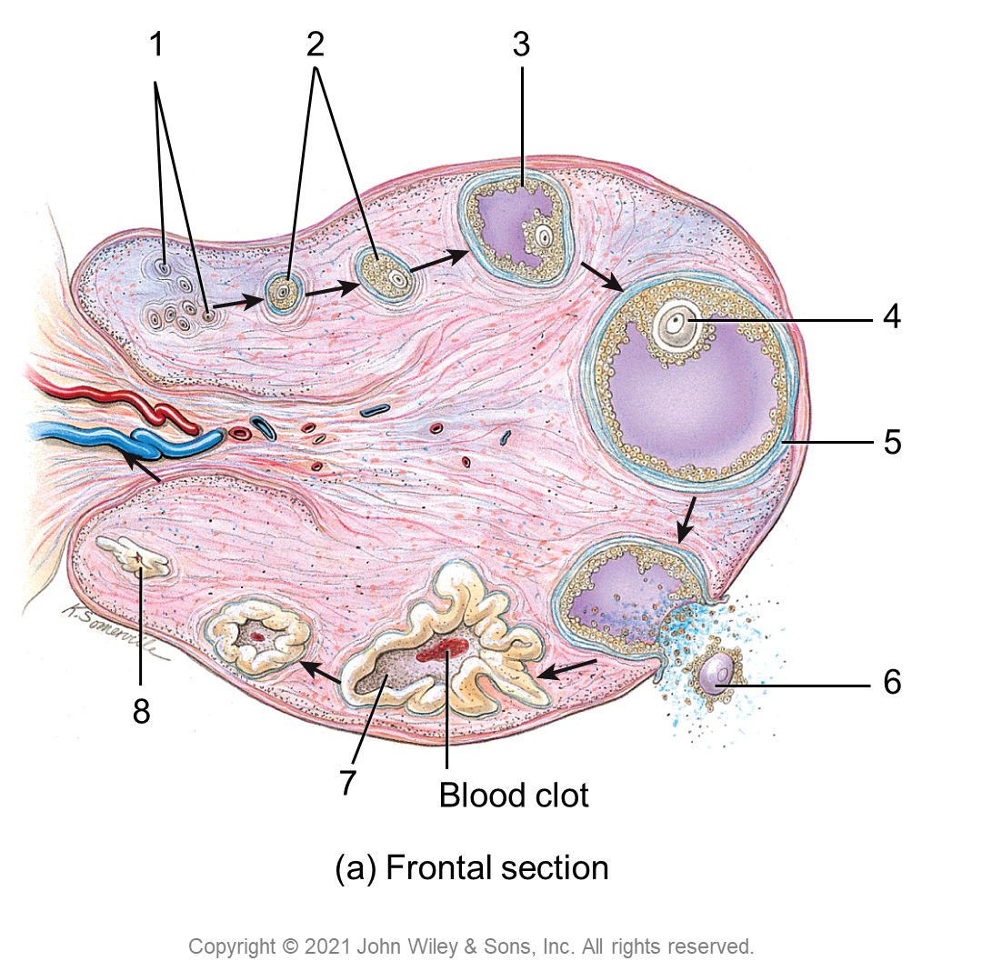
1
2
3
4
5
6
8
7
Blood clot
(a) Frontal section
Copyright © 2021 John Wiley & Sons, Inc. All rights reserved.

Slide 15
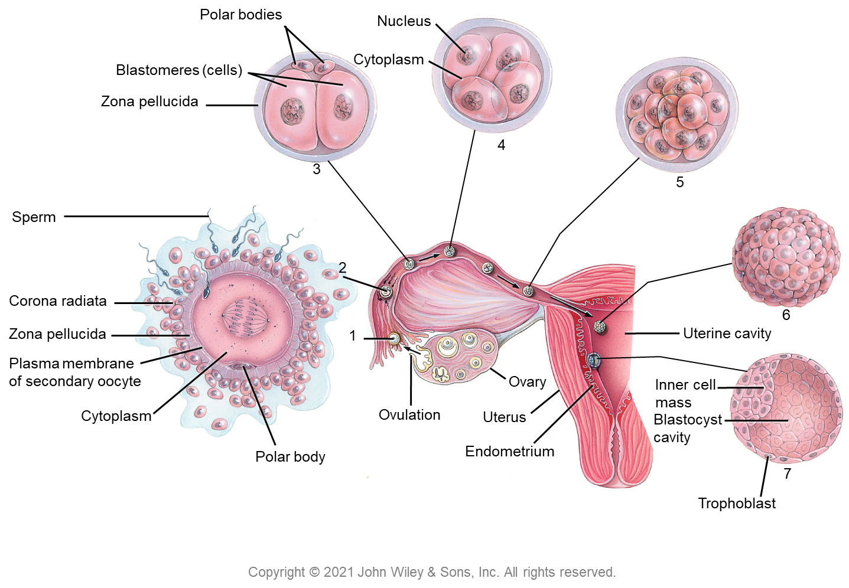
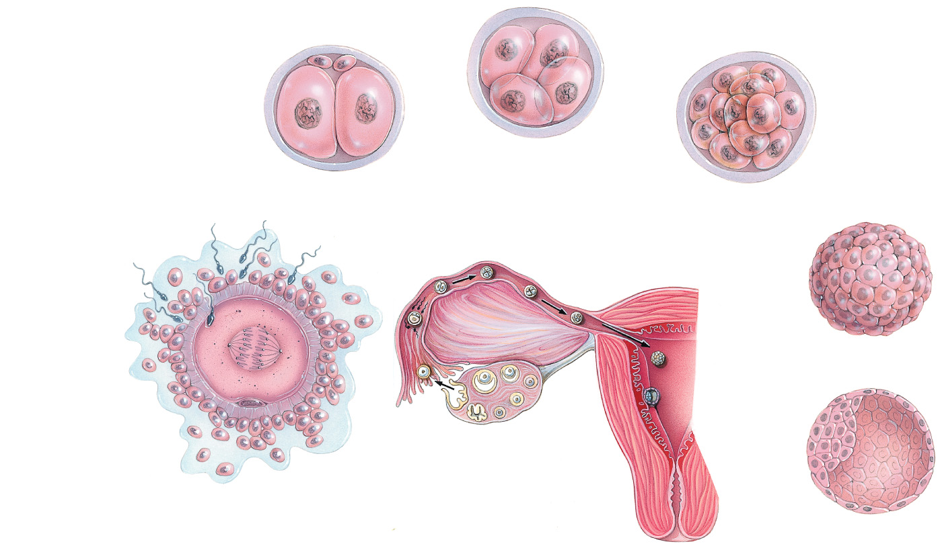
Polar bodies
Nucleus
Blastomeres (cells)
Cytoplasm
Zona pellucida
4
3
5
Sperm
2
Corona radiata
6
Zona pellucida
1
Uterine cavity
Plasma membrane
of secondary oocyte
Ovary
Inner cell
mass
Cytoplasm
Ovulation
Uterus
Blastocyst
cavity
Polar body
Endometrium
7
Trophoblast
Copyright © 2021 John Wiley & Sons, Inc. All rights reserved.

Slide 16
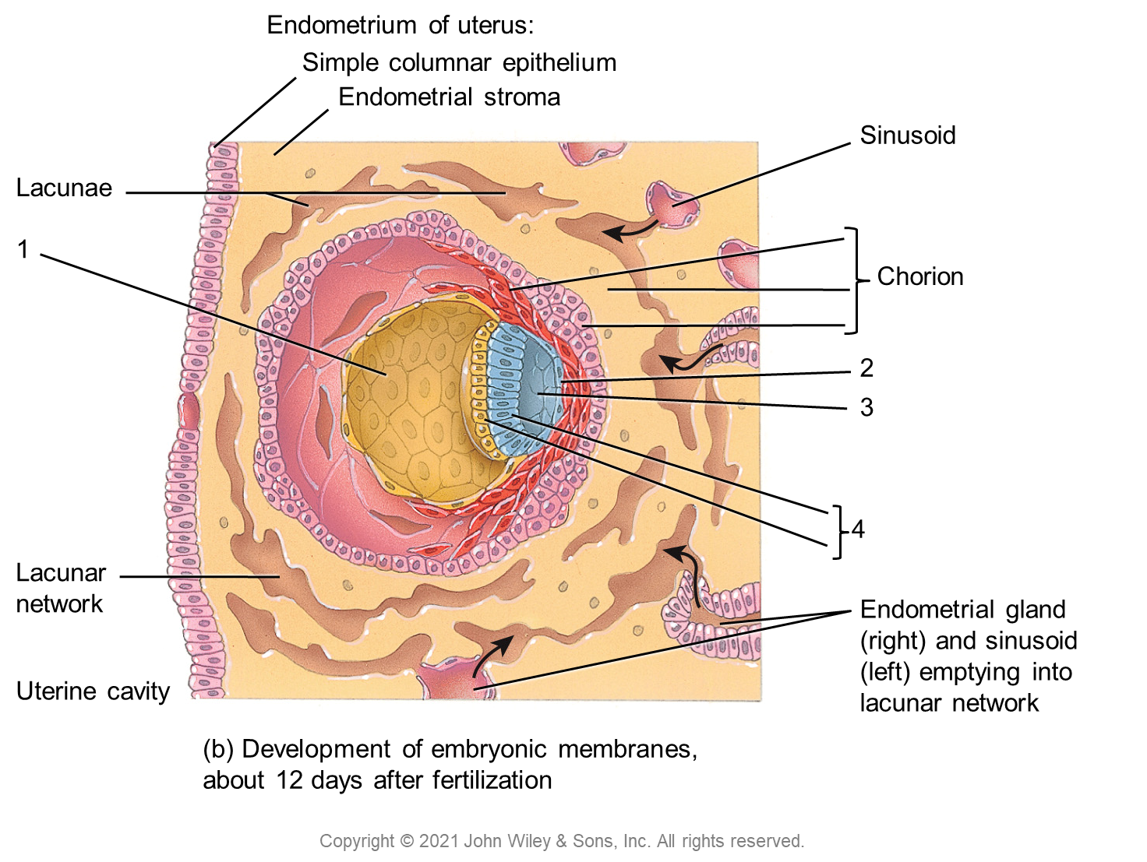
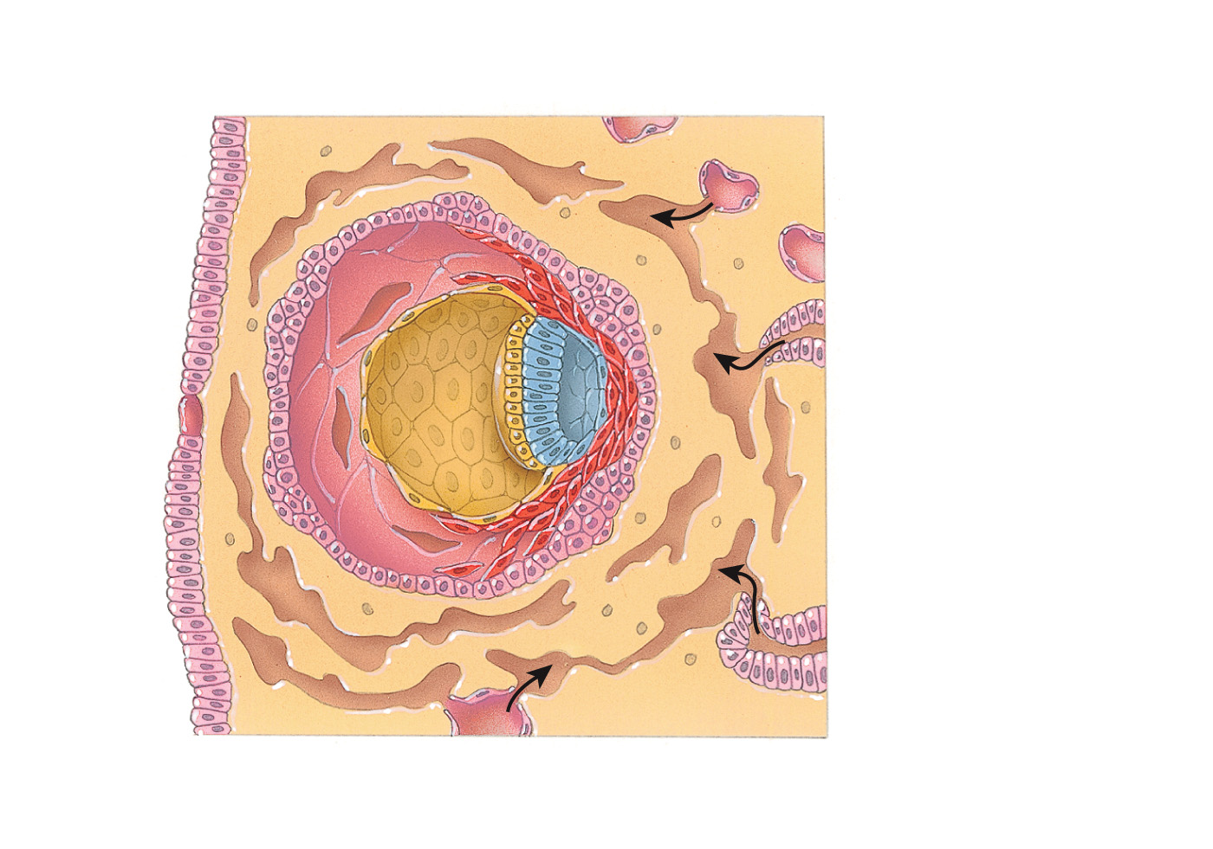
Endometrium of uterus:
Simple columnar epithelium
Endometrial stroma
Sinusoid
Lacunae
1
Chorion
2
3
4
Lacunar
network
Endometrial gland (right) and sinusoid (left) emptying into lacunar network
Uterine cavity
(b) Development of embryonic membranes,
about 12 days after fertilization
Copyright © 2021 John Wiley & Sons, Inc. All rights reserved.

Slide 17
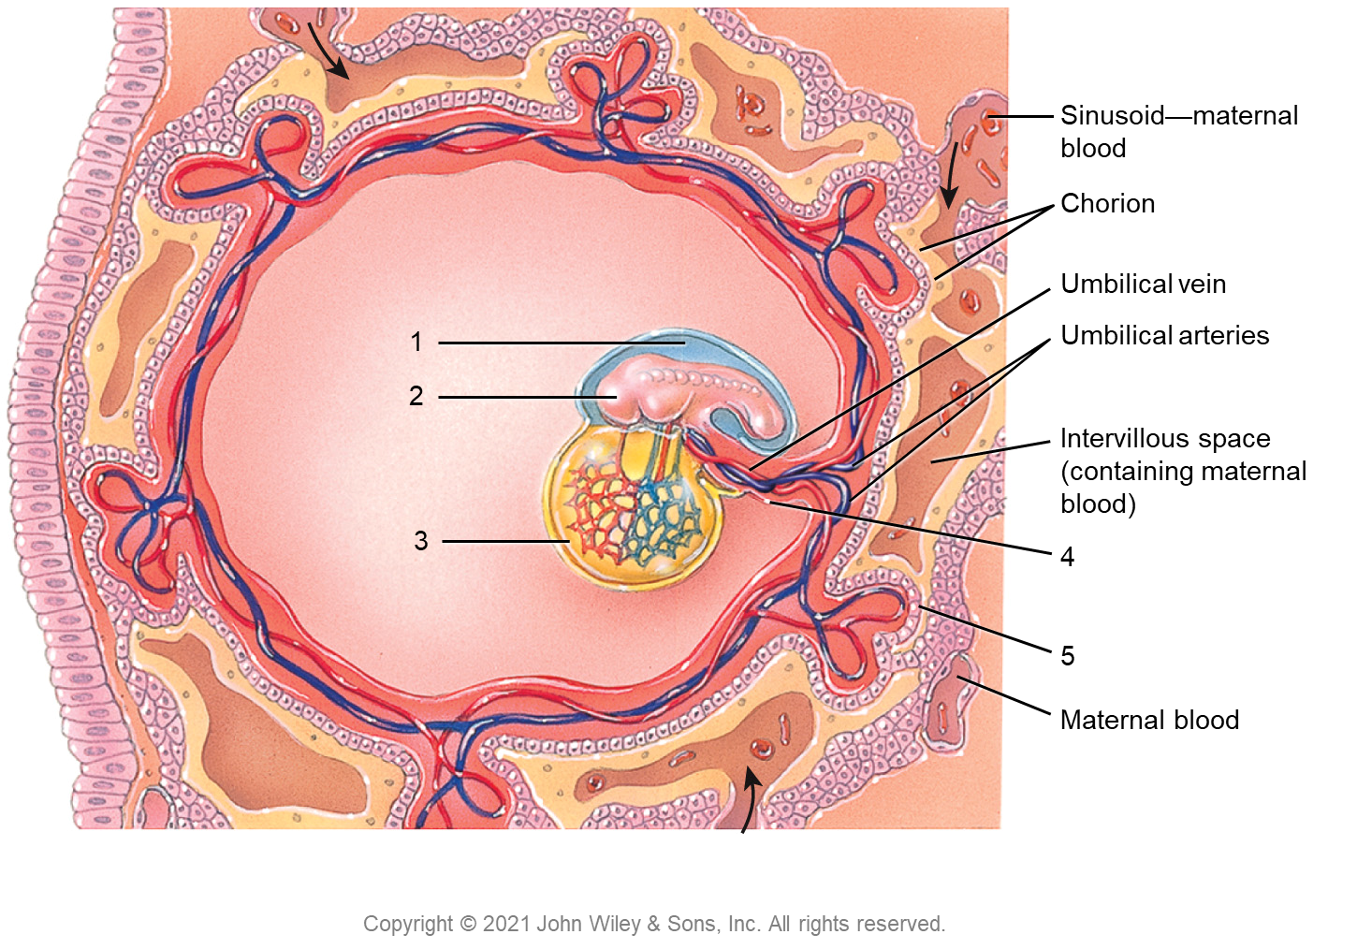
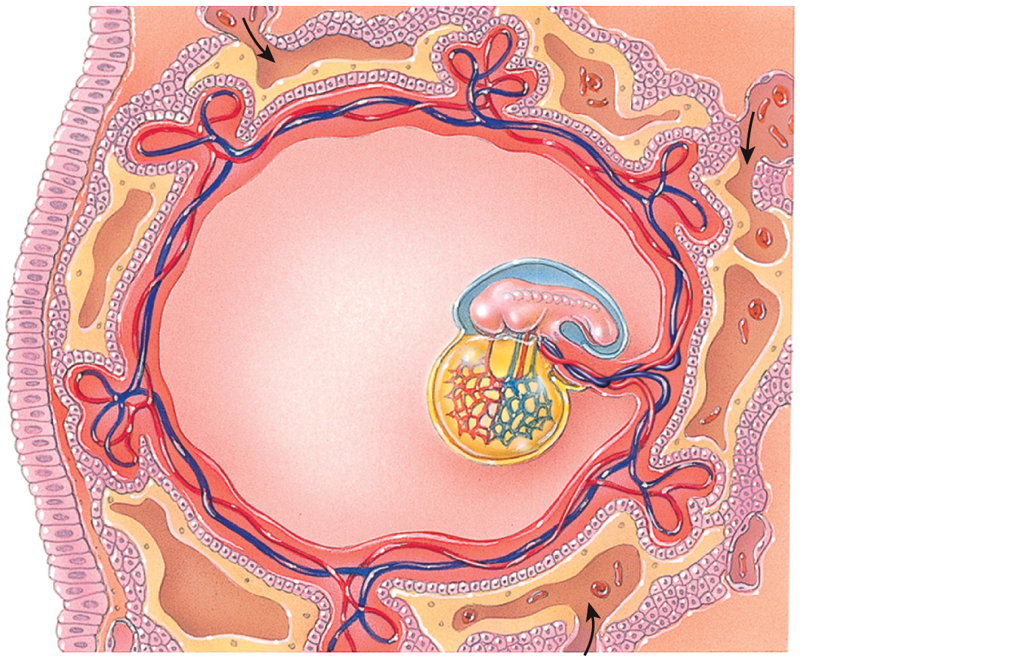
Sinusoid—maternal blood
Chorion
Umbilical vein
1
Umbilical arteries
2
Intervillous space
(containing maternal blood)
3
4
5
Maternal blood
Copyright © 2021 John Wiley & Sons, Inc. All rights reserved.

Slide 18
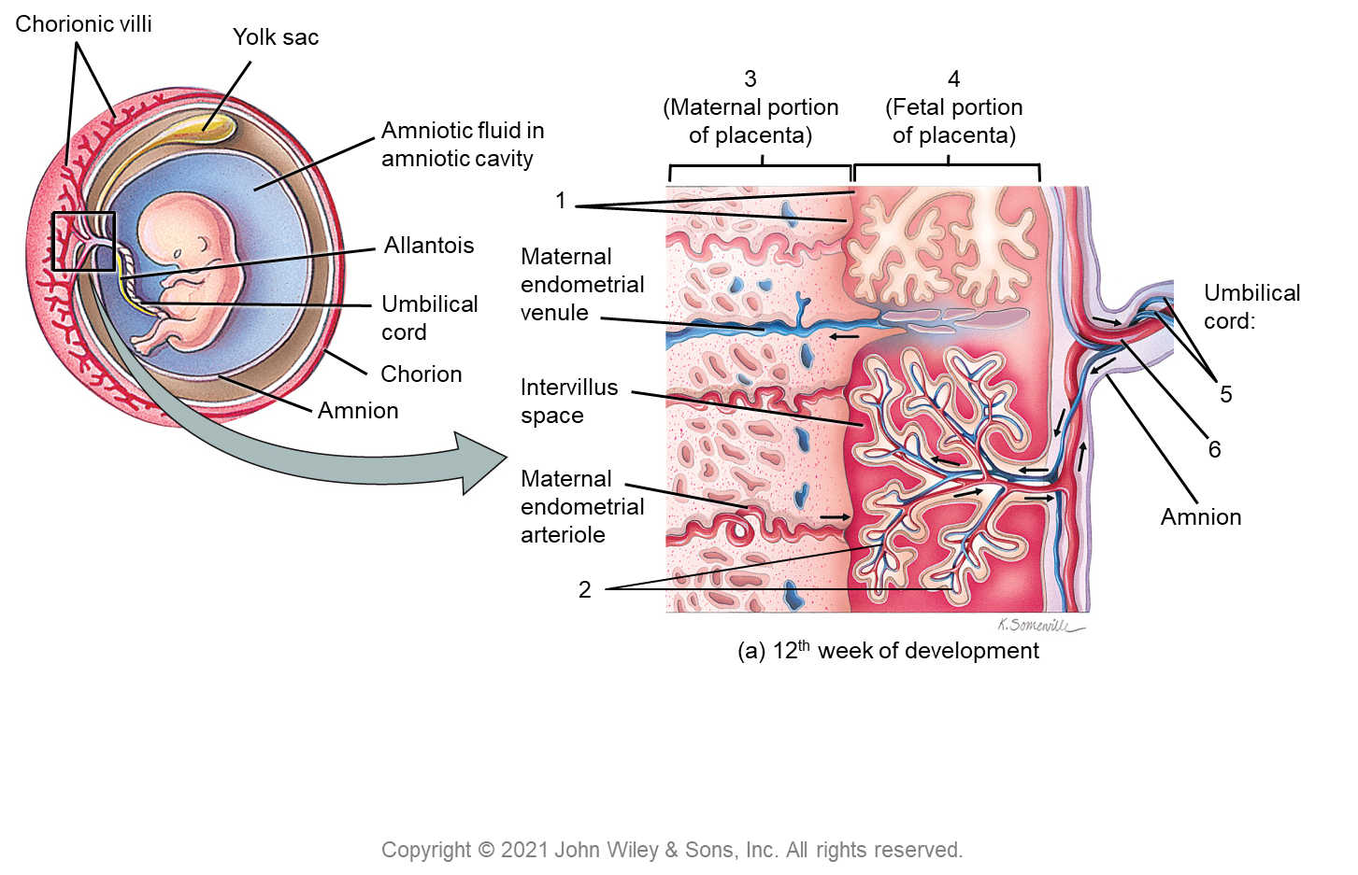
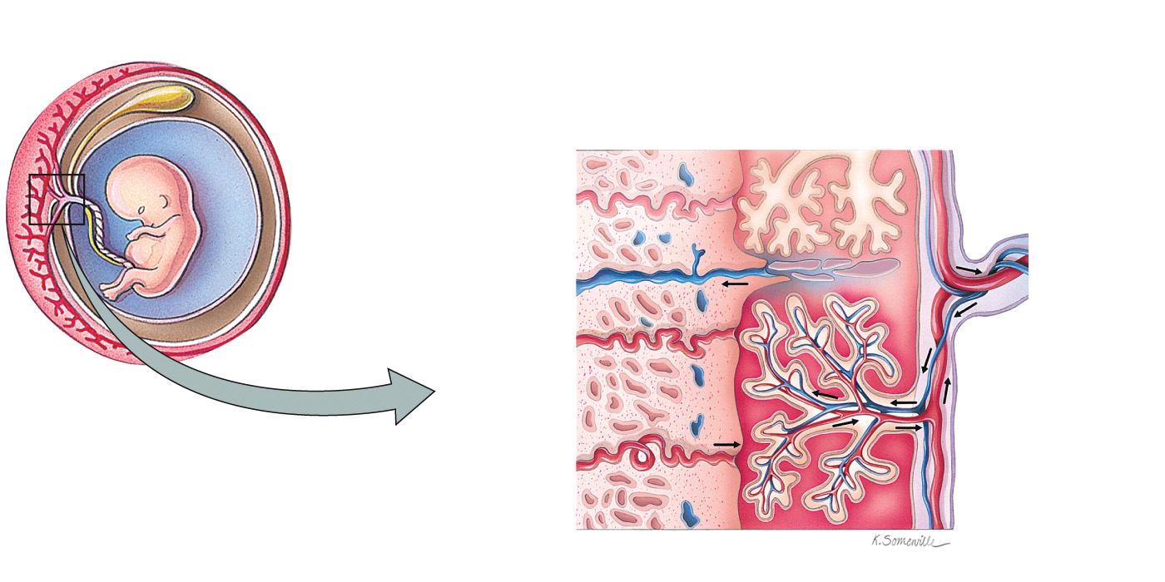
Chorionic villi
Yolk sac
3
(Maternal portion
of placenta)
4
(Fetal portion
of placenta)
Amniotic fluid in
amniotic cavity
1
Allantois
Maternal
endometrial
venule
Umbilical
cord
Umbilical cord:
Chorion
Intervillus
space
Amnion
5
6
Maternal
endometrial
arteriole
Amnion
2
(a) 12th week of development
Copyright © 2021 John Wiley & Sons, Inc. All rights reserved.

